Slide 1


SENTIMENT ANALYSIS
AVINASH ALAPATI
DSC 680

Slide 2
INTRODUCTION
Sentiment analysis can be defined as a process that automates mining of attitudes, opinions, views and emotions from text, speech, tweets and database sources through Natural Language Processing (NLP).
The main goal of this analysis is to discover the underlying sentiment from a user’s tweet.
The opinions that are mined will be classified into two categories positive and negative.
An analysis will then be performed on the classified data to see what percentage of the population sample fall into each category.

Slide 3

BUSINESS PROBLEM
An impactful application involves discerning a customer's perspective on a product, providing invaluable data for companies.
By analyzing this information, a company can pinpoint product issues, anticipate trends ahead of competitors, and enhance communication with their target audience.
Additionally, it offers a valuable assessment of the effectiveness of marketing campaigns.
Armed with this knowledge, companies receive crucial feedback, enabling them to refine and innovate for the development of the next generation of their products.

Slide 4

APPROACH
DATA COLLECTION
DATA CLEANSING
DATA CLASSIFICATION
DATA ANALYSIS

Slide 5
DATA COLLECTION
The dataset provided is the Sentiment140 Dataset which consists of 1,600,000 tweets that have been extracted using the Twitter API. The various columns present in the dataset are:
target: the polarity of the tweet (positive or negative)
ids: Unique id of the tweet
date: the date of the tweet
flag: It refers to the query. If no such query exist’s then it is NO QUERY.
user: It refers to the name of the user that tweeted
text: It refers to the text of the tweet

Slide 6
DATA CLEANSING
Remove all URLs, hash tags ( #topic), targets (@username)
Remove Stop words.
Replace Repeated Characters.
Remove all punctuations, symbols, numbers.

Slide 7
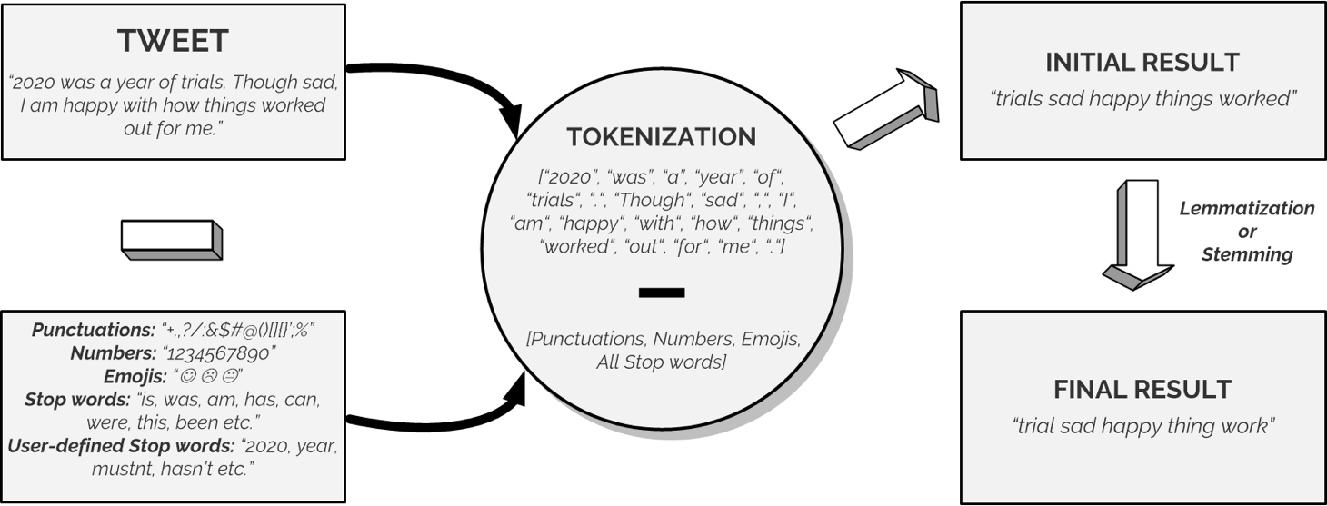
Data Classification
Tokenization" : A method of splitting a sentence into smaller units called "tokens" to remove unnecessary elements.
"Lemmatization". This is a process of returning words to their "base" form.

Slide 8


Data Classification

Slide 9
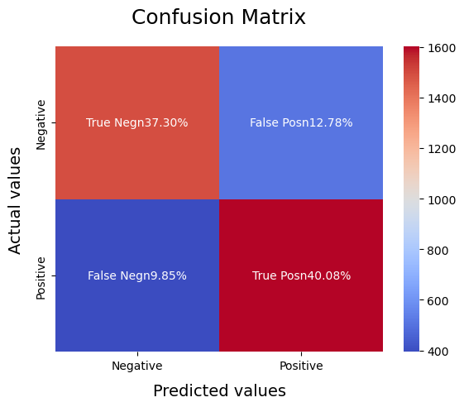
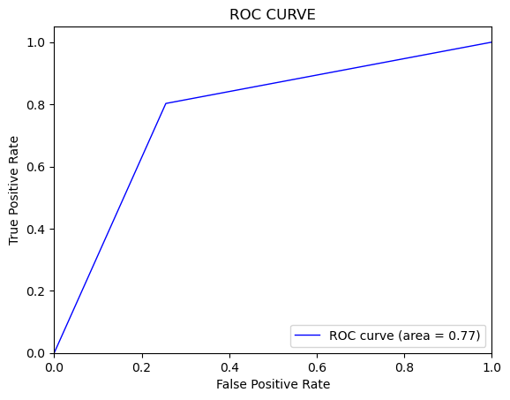
SVM

Slide 10
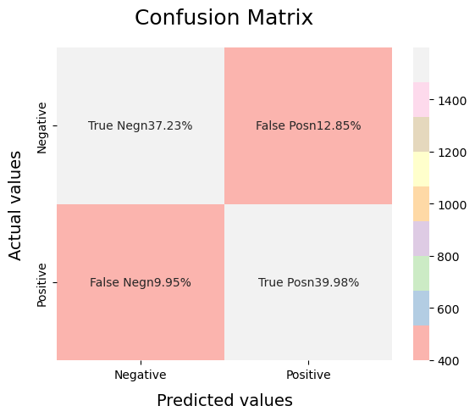
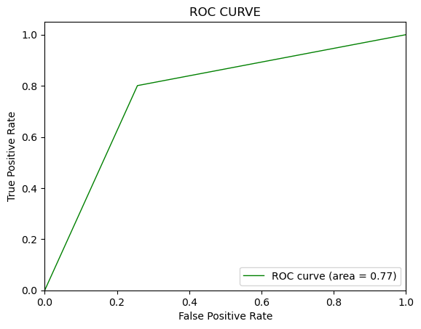
Logical Regression

Slide 11

CONCLUSION
Overall, we found that Logistic Regression is the best model for analyzing Sentiments on the dataset.
For a particular problem statement if the data has no assumption, then the simplest model works the best.

Slide 12

THANKYOU

